Slide 1
MARKET MAKING WITH MACHINE LEARNING
Kevin Chen, Kapil Kanagal, Yu Wu

Slide 2
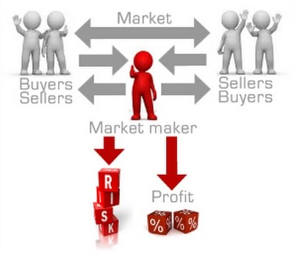
Market making Explained
Market Makers provide liquidity in an exchange by quoting both a bid and ask price in a financial instrument
Make profit by taking advantage of the bid-ask spread

Slide 3
Market Making Example
Person 1 (Seller)
Ask
$201
$199
1 iPod
Market Maker
+$2.00
Price
$199
$201
1 iPod
Bid
Person 2 (Buyer)

Slide 4
Strategy outline
Look at market book data and periodically PREDICT evolution of stock price with machine learning model
post bid and ask orders adjusted for this evolution
If only one side only is hit after a waiting period, cancel order and post new adjusted quotes

Slide 5
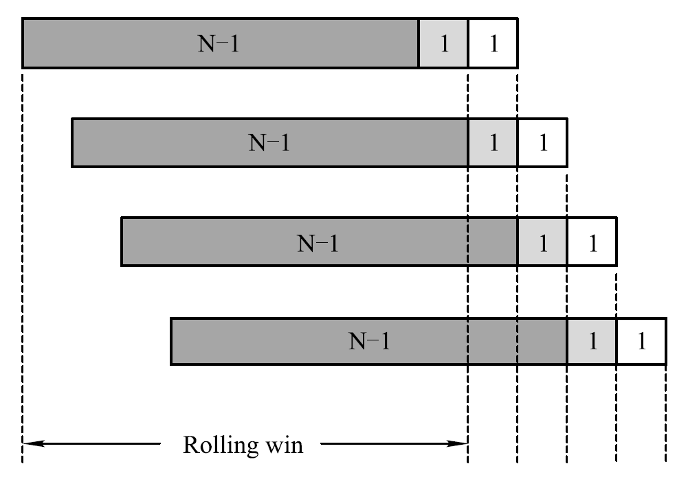
Preamble Strategy training
Sampling of market book data
MACHINE LEARNING PREDICTION from historical data
Li, Deng, Zhu, Wang, Xie; An intelligent market making strategy in algorithmic trading

Slide 6
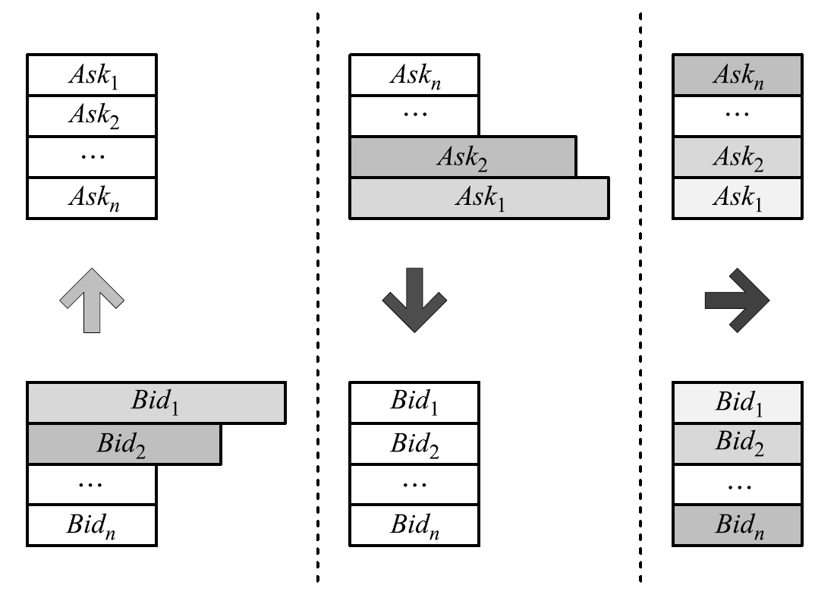
data
Market book data containing price and queue size of the first few levels of bids and asks.
Combined to measure relative size of ask and bid sides over different time periods
Choice of threshold
Conservative vs liberal estimates
Li, Deng, Zhu, Wang, Xie; An intelligent market making strategy in algorithmic trading

Slide 7
Predicting with SVM
Details on training SVM
Discuss the process to fit and validate the model, how good the model is, any patterns in the data, any optimization used

Slide 8
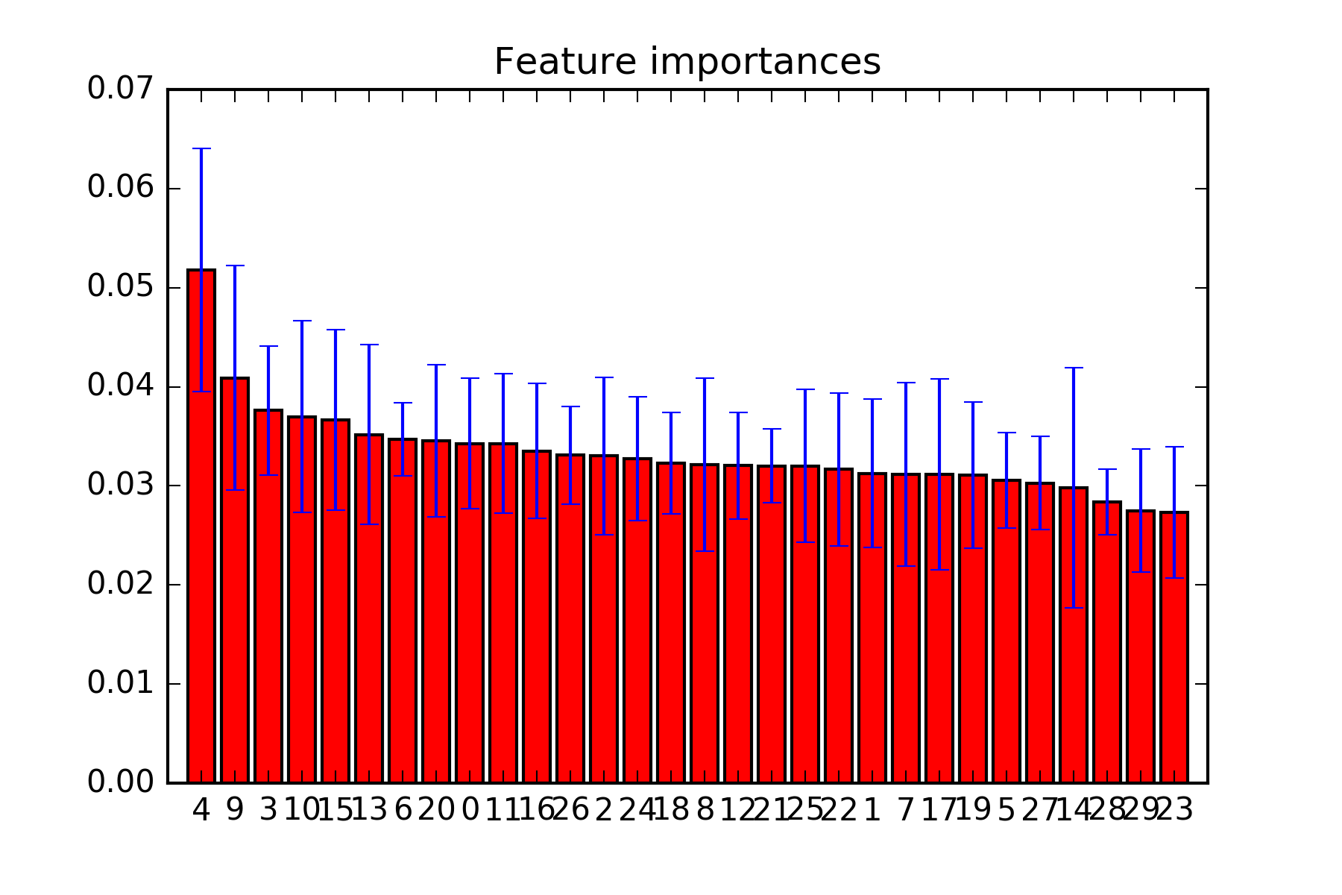
Predicting with Random forest
DECISION TREE
Average decision trees to obtain random forest with less variance
Cross validation on 20% of the training set

Slide 9
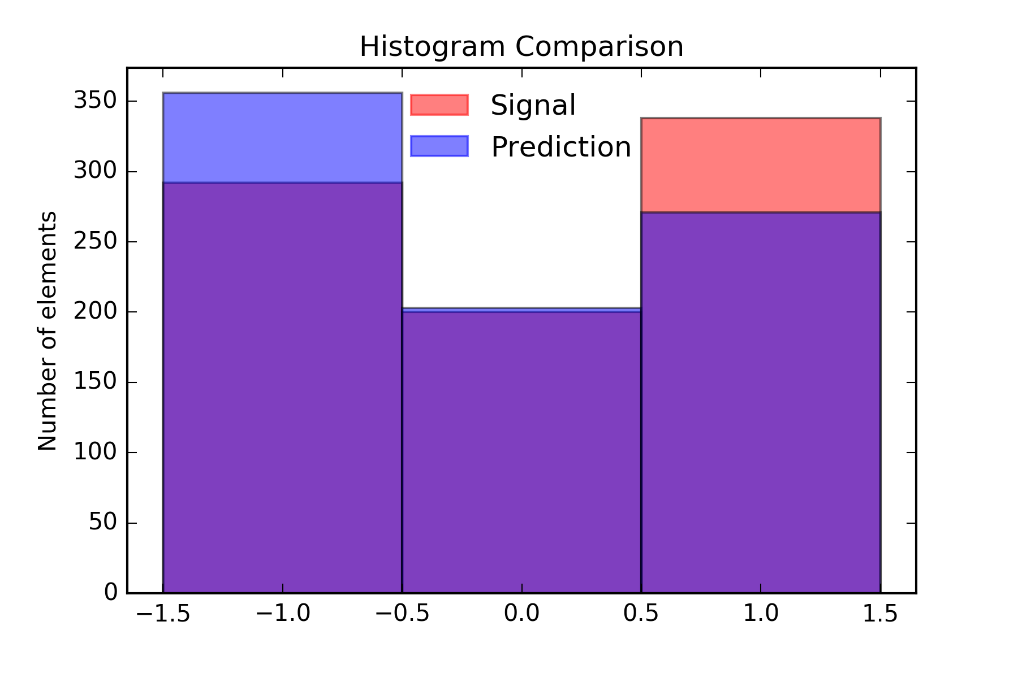
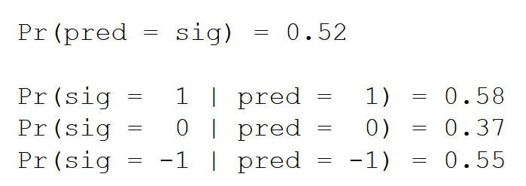
Predicting with Random forest

Slide 10
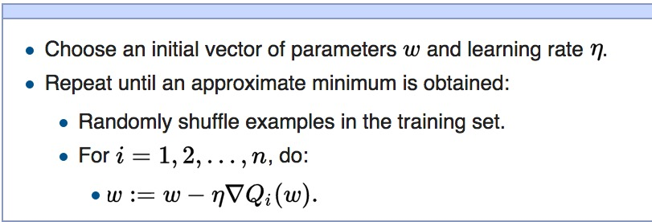
Prediction with linear models - SGD
Training Our Linear Model
Iteratively fits 100 linear models on 4830 data points in our 15-day rolling window
First 4000 points are training set // All other points are in validation set
SGD Linear Model from sklearn is fit to training data Stochastic Gradient Descent
w = vector of zeroes of size n
n = length of training set (4000)
This process is repeated 500 times to find min
Q_{i}(w) is objective (log loss) function
η is the learning rate (internally optimized)

Slide 11
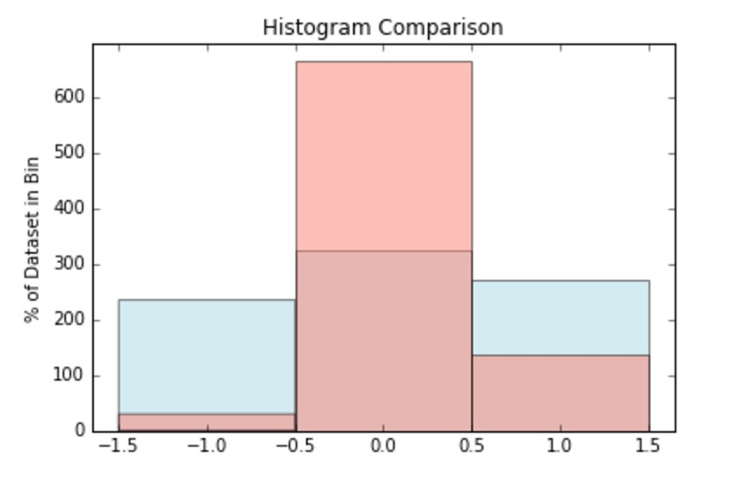
Prediction with linear models - SGD
Results
% of total correct predictions: 38.733
% of total positive predictions: 14.033
% of total neutral predictions: 82.486
% of total negative predictions: 7.183
Overpredicting the number of neutral signals → missing some correct and many negative signals
Notes:
These results are on the ticker IVV for the S&P 500 Index

Slide 12

Risk management
Adverse Scenarios
Extra inventory → need to unwind position at end of day and do not want to lose money doing so
Want to predict signals to ensure you are utilizing directionality of market movement in bid-ask posting
Stop loss
If(short and market price < price we sold asset)
Buy back asset
Else if(long and market price > price we bought asset)
Sell off asset
Notes:
Stop Loss help optimize position, especially on the short side, to limit losses
This allows our strategy to become profitable

Slide 13
results
Forecast accuracy, confusion matrix
PnL, Sharpe ratio, max draw down, VaR/cVaR?, percentage of trade profitable for strategy
Turn over rates, holding period
Pretty graphs and shit

Slide 14

What we learned
Don’t make losing trades
Don’t always post at best bid/ask
Thesys is unreliable
Trading and making money is HARD WORK!
What works on one market (Nikkei) is not always successful on another (NYSE)

